Slide 1
LEVEL UP | WORLD 1 | EXERCISE
Explaining
the
Internet
Camilla Maria Minutilli, Sr. Software Engineer 1
Lauren Butler, Financial Accountant
Thanmai D L, System Administrator 1
Notes:
This PowerPoint Template includes a series of slide masters with predefined layouts and color schemes for formatting slides
Slide Masters are displayed when you right click on a slide and select Layout from menu

Slide 2
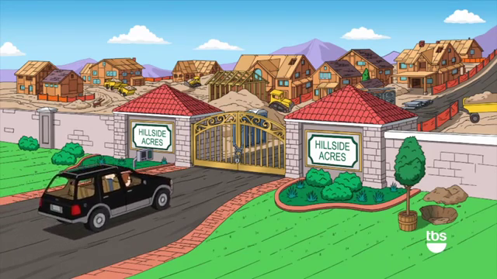
What is an Autonomous System?
The Internet is a network of networks, and autonomous systems are the big networks that make up the Internet.
More specifically, an autonomous system (AS) is a large network or group of networks that has a unified routing policy.
Every computer or device that connects to the Internet is connected to an AS.
Notes:
The gated community represents the AS. Every building represents maybe a branch office and each flat represents a endpoint.

Slide 3

What is a Packet?
Plastic wrappers used to pack crunchy chips, rich creamy chocolates or Capri sun is called a packet –
A packet is a small segment of a larger message. Data sent over computer networks, such as the Internet, is divided into packets. These packets are then recombined by the computer or device that receives them.

Slide 4
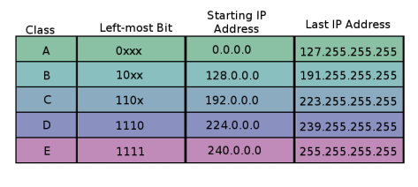
What is an IP Address?
An IP address is a unique address that identifies a device on the internet or a local network. IP stands for "Internet Protocol", which is the set of rules governing the format of data sent via the internet or local network.
2 types of IP addresses
IPv4
IPv6
IP address are divided into classes.
Notes:
IP address are unique names for computers, but their names are numbers instead of words.

Slide 5
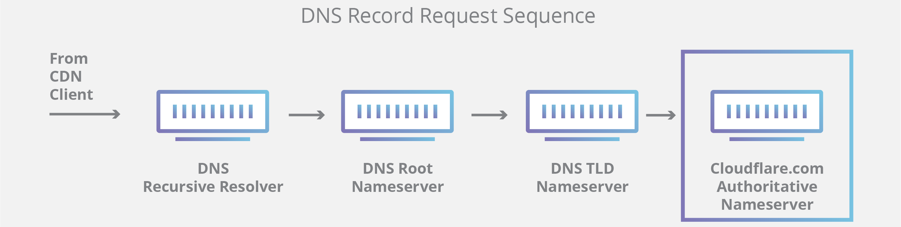
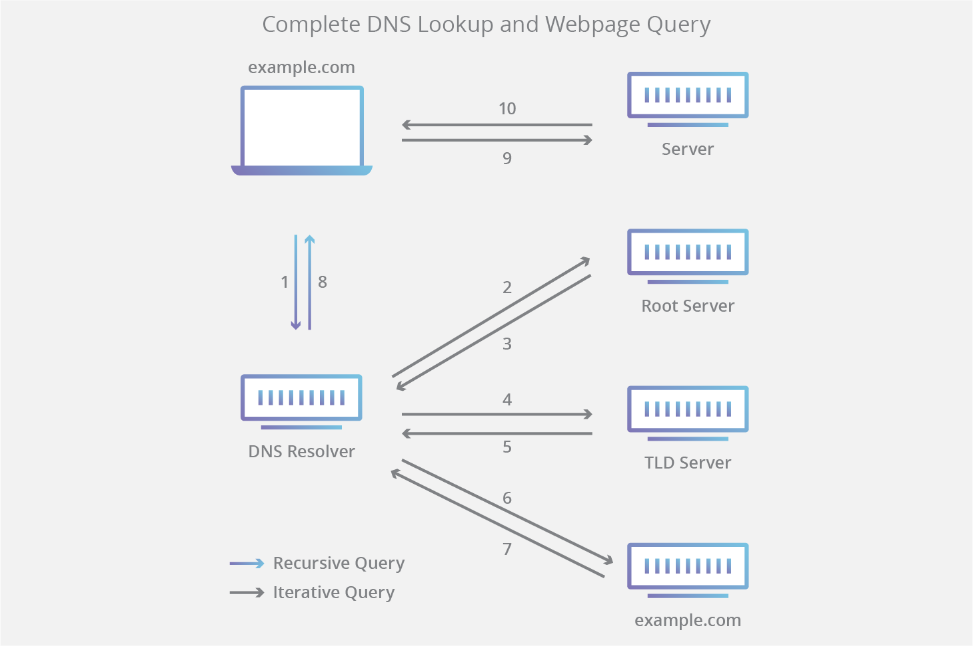
What is DNS?
The Domain Name System (DNS) is the phonebook of the Internet. Humans access information online through domain names, like nytimes.com or espn.com. Web browsers interact through Internet Protocol (IP) addresses.
There are 4 DNS servers involved in loading a webpage i.e., DNS recursor, Root, TLD and Authoritative nameserver.
3 types of DNS queries
Recursive query
Iterative query
Non-recursive query

Slide 6

What is Traceroute?
A traceroute works by sending Internet Control Message Protocol (ICMP) packets, and every router involved in transferring the data gets these packets. The ICMP packets provide information about whether the routers used in the transmission can effectively transfer the data.
Why do we need traceroute? (Good question)
If a Swiss knife was used for network troubleshooting, then traceroute would be a part of it.
An Internet Protocol (IP) tracer is helpful for figuring out the routing hops data has to go through, as well as response delays as it travels across nodes, which are what send the data toward its destination.
Traceroute also enables you to locate where the data was unable to be sent along, known as points of failure. You can also perform a visual traceroute to get a visual representation of each hop.

Slide 7
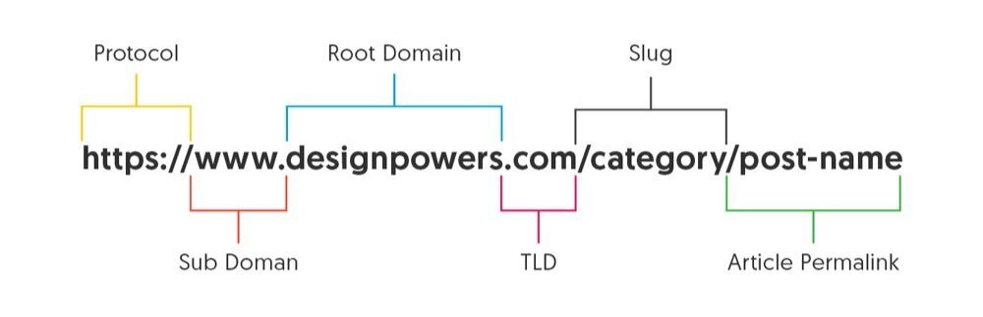
What is a URL?
A URL (Uniform Resource Locator) is a unique identifier used to locate a resource on the Internet. It is also referred to as a web address. URLs consist of multiple parts -- including a protocol and domain name -- that tell a web browser how and where to retrieve a resource.
End users use URLs by typing them directly into the address bar of a browser or by clicking a hyperlink found on a webpage, bookmark list, in an email or from another application.

Slide 8
What does a Router Do?
A router is a device that connects two or more networks or subnetworks.
Routers come into play in the network layer. Each router maintains a routing table with a set of routes which are looked up on arrival of packets that need to be routed.
Think of a router as an air traffic controller and data packets as aircraft headed to different airports (or networks). Just as each plane has a unique destination and follows a unique route, each packet needs to be guided to its destination as efficiently as possible.
In the same way that an air traffic controller ensures that planes reach their destinations without getting lost or suffering a major disruption along the way, a router helps direct data packets to their destination IP address.

Slide 9
What does a Server Do?
A server is a software or hardware device that accepts and responds to requests made over a network.
Few functions of a server are:
Serving Client Computer Requests
Storing Data or Information
Provide a Database to Run
Manage Data or File Transfer Traffic
Safeguard from Evil Attack
There are different types of servers like:
Web Server
Mail Server
Application Server
Database Server
FTP or DHCP Server

Slide 10
What is a Node?
A node is a device or data point in a larger network.
A node can be a couple of different things depending on whether the conversation is about computer science or networking.
In networking a node is either a connection point, a redistribution point, or a communication endpoint.
In computer science, nodes are devices or data points on a large network, devices such a PC, phone, or printer are considers nodes.
In general, a node has a programmed or engineered capability that enables it to recognize, process, or forward transmissions to other nodes.

Slide 11
What is TCP?
Transmission Control Protocol is a layer 4 i.e., transport layer protocol.
TCP is connection-oriented.
Before sending data to the destination host, the two hosts communicate to establish a connection. Once the connection is established, the data exchange begins.
TCP provides reliable communication.
The destination host must acknowledge that it received each TCP segment. If a segment isn’t acknowledged, it is sent again.
TCP provides sequencing.
Sequence numbers in the TCP header allow destination hosts to put segments in the correct order even if they arrive out of order.
TCP provides flow control.
The destination host can tell the source host to increase/decrease the rate that data is sent.

Slide 12
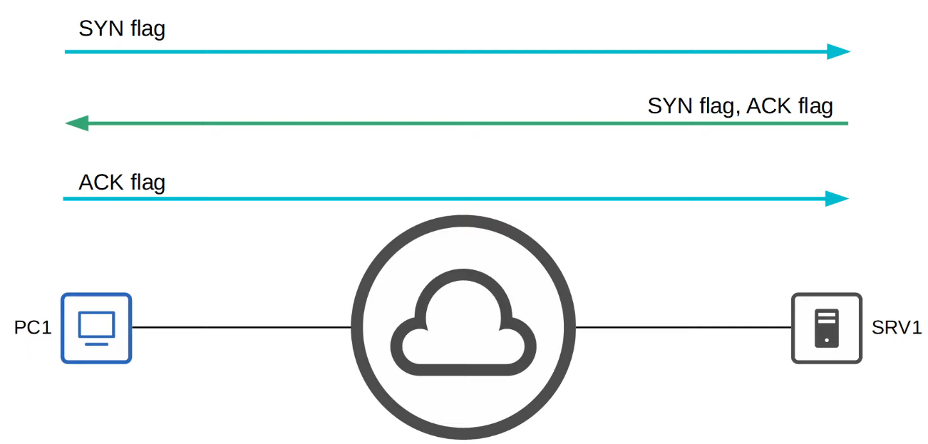
The Three-way HANDSHAKE
This is how client and server establish a connection.
Notes:
Look up 4-way handshake. Not widely known but it is used to terminate a connection which is established.

Slide 13
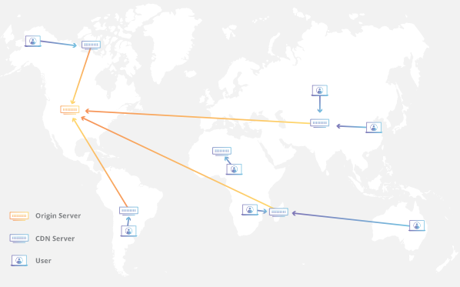
What is a CDN?
A content delivery network (CDN) refers to a geographically distributed group of servers which work together to provide fast delivery of Internet content.
A CDN allows for the quick transfer of assets needed for loading Internet content including HTML pages, JavaScript files, stylesheets, images, and videos.
Benefits you ask? (Here you go)
Improving website load times
Reducing bandwidth costs
Increasing content availability and redundancy
Improving website security

Slide 14
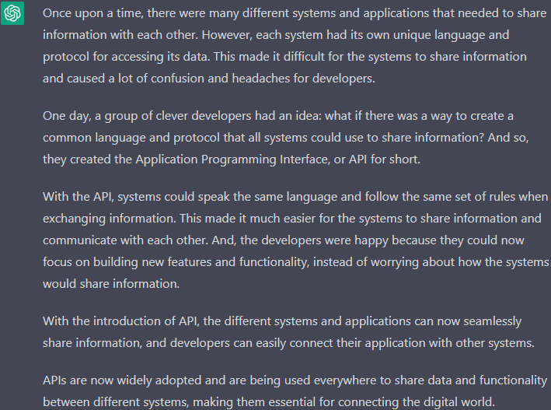
What is an API?
An application programming interface is a way for two or more computer programs to communicate with each other.
Here’s a story on API by ChatGPT:

Slide 15
What is an ISP?
An Internet Service Provider (ISP) is a company that provides internet access to customers. ISPs offer a variety of services, such as DSL, cable, fiber-optic, and satellite internet access, as well as different plans with varying speeds and data allowances.
ISPs are responsible for providing the necessary infrastructure and technology to connect customers to the internet. This includes laying cables, setting up wireless networks, and installing the necessary equipment in customer's homes or businesses.
ISPs also handle the routing of internet traffic, connecting customers to websites and other online services by routing their traffic through the necessary networks and servers. ISPs also typically provide customers with a unique IP address, which is used to identify the customer's device on the internet.
ISP also provide other services such as Email hosting, web-hosting and other Internet related services, and many times provide additional services such as phone and TV along with the internet services.

Slide 16

Explain “the Cloud” (Cloud Computing)
At a high level, cloud computing refers to the delivery of computing resources over the internet, on-demand. Rather than purchasing and maintaining physical hardware and software, organizations can use cloud-based services to access the computing resources they need, when they need them.
Imagine a large building called "cloud data center" which has many rooms. Each room represent a different service like storage, computing power, software, databases etc. And this building can be access from any location by the customers via internet.
Now, imagine you are running a small business and you need some storage to keep your data. Rather than buying a physical hard drive or server, you can simply rent some space in the "cloud data center" - you pay only for the space you use and can scale up or down as your needs change. This is like how you pay for electricity or water at home.
SaaS, PaaS and IaaS are services that can be provided through the cloud.
Notes:
Mention the different types of clouds like Public, Private, Hybrid and Community

Slide 17

Heads “UP”

Slide 18
Explain “Distributed Work”
Distributed work refers to a way of organizing and managing work that allows employees to work remotely and communicate with each other over a network, rather than working in a central office location. This type of work organization has become more common in recent years, due to advances in technology that make it possible for employees to collaborate and communicate effectively regardless of their physical location.
In a distributed work setup, employees can work from anywhere they choose, whether it's from their home, a co-working space, or a café. They use a variety of tools, such as video conferencing, messaging, and project management software, to communicate with their colleagues and collaborate on projects. This setup is also known as remote working or telecommuting.

Slide 19
Explain “Distributed Work”
One of the advantages of distributed work is that it provides employees with more flexibility in terms of where and when they work. This can improve work-life balance and help to reduce stress. It can also make it easier for organizations to attract and retain talent from a wider geographical area and reduce the need of expensive office space.
However, distributed work also brings some challenges. One is the need to ensure that employees feel connected and engaged with their colleagues and the organization, even when they're not physically together. Another challenge is to maintain effective communication and collaboration among team members who are in different locations. And managing work schedule, attendance and tracking productivity can be more challenging than in a traditional office setting.
Overall, distributed work is becoming an increasingly popular way of organizing and managing work, and with the right tools, processes, and management approach, it can be beneficial for both employees and organizations.

